Slide 1
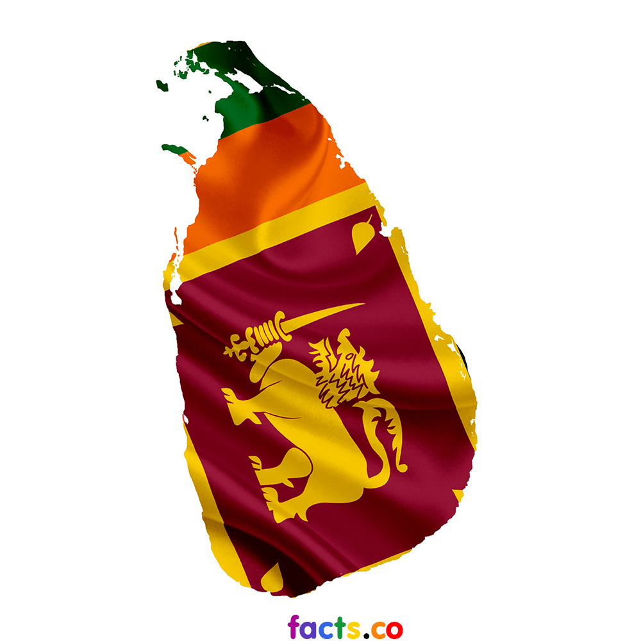
Disability Context in Sri Lanka
Manika Opatha
Master of Disability Studies
Flinders University. SA

Slide 2
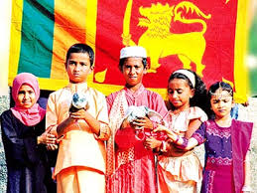
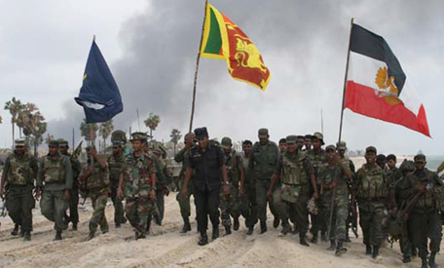
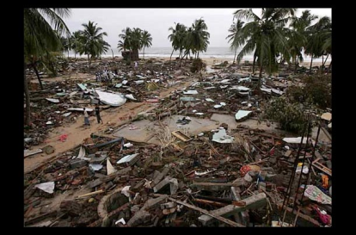
Introduction
Sri Lanka….
(The Democratic Socialist Republic of Sri Lanka)
A developing country in the South Asia
A diverse country accommodates many religions, ethnicities & languages
Rich with vast bio diversity
A leading exporter of tea, coffee, coconut, & gemstones etc.
Has been marred by a three decades of civil war & decisively ended in 2009
Recovered through grief & optimism to a certain extent after the tragedy of tsunami in 2004
Still have certain survivals of historical calamities

Slide 3
What Disability means to Sri Lanka?
“Persons with disabilities” means any person who, as a result of any deficiency in his/her physical or mental capabilities, whether congenital or not, is unable by himself /herself to ensure for himself/herself, wholly or partly, the necessities of life.
(Protection of the Rights of Persons with Disabilities Act, No.28 of 1996 )

Slide 4
Current situation
The population of people with disability grew alarmingly over last few years as a result of civil war and due to natural disasters, accidents & other general factors
Rapid increase of aged population is also an added burden.
There are number of accessible issues all over the country mainly with public buildings, transport and other infrastructure (education, employment, entertainment, etc.)

Slide 5
Stake Holders in Disability Services
The Ministry of Social Services, Welfare & Livestock Development
- Department of Social Services
The Ministry of Health
The Ministry of Education
NGOs
Other volunteer organizations

Slide 6
Department of Social Services
Mission
“To make those who are subject to disadvantaged situation in the society, active stakeholders in the national development process by providing needy services and empowering them”
objectives:
Ensure equal rights and opportunities of people with disabilities
Policy implementation & action plans for service provision
Rehabilitation, service provision for skill development and employment opportunities for people with disabilities
Early intervention programs for children with special needs
Community re-integration of drug addicts
Training and awareness programs for skill development of service providers

Slide 7
Hierarchy of community based disability services
Disabled persons and the family
↓
Community Level (villages and Grama Nildhari areas)
↓
Divisional Secretary Level
↓
District Level
↓
Provincial Level
↓
National Level

Slide 8
Ctd…….
Helping hands from international community are positively impacted on most of the currently available disability welfare services
Sri Lankan Government is acknowledge volunteer/ NGO & international services at all time

Slide 9
Practically,
There are some mismatches of services provide for people with disabilities and their actual needs
use “free size model” of services to address specific needs of individuals
lack of relevant knowledge among service providers about specific disabilities
Poor communication among stake holders
Poor monitoring of quality of ongoing disability services by relevant authorities

Slide 10
Physiotherapist’s role in Disability Service
Plays a vital role where individual’s mobility is limited by a disability.
A leading character in service provision to enhance functional capabilities of people with disabilities.
Assessment, initiation and facilitation of therapy care in long term management
Ensure minimization of likelihood of disease/condition progression
Optimize social inclusion through alleviation of possible personal and physical barriers.
Promotes physical and psychological wellbeing

Slide 11
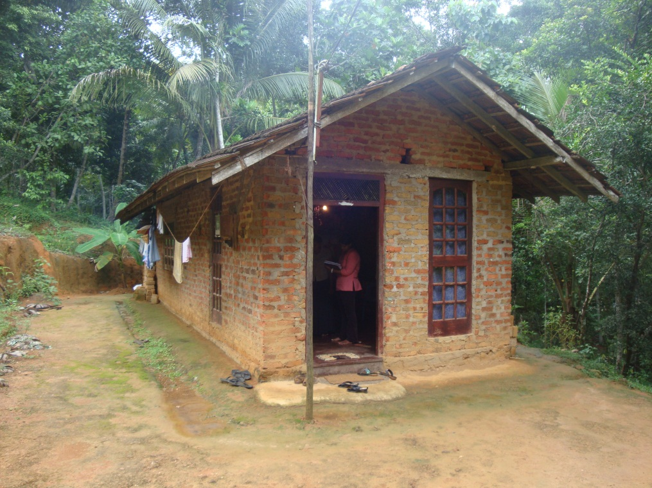
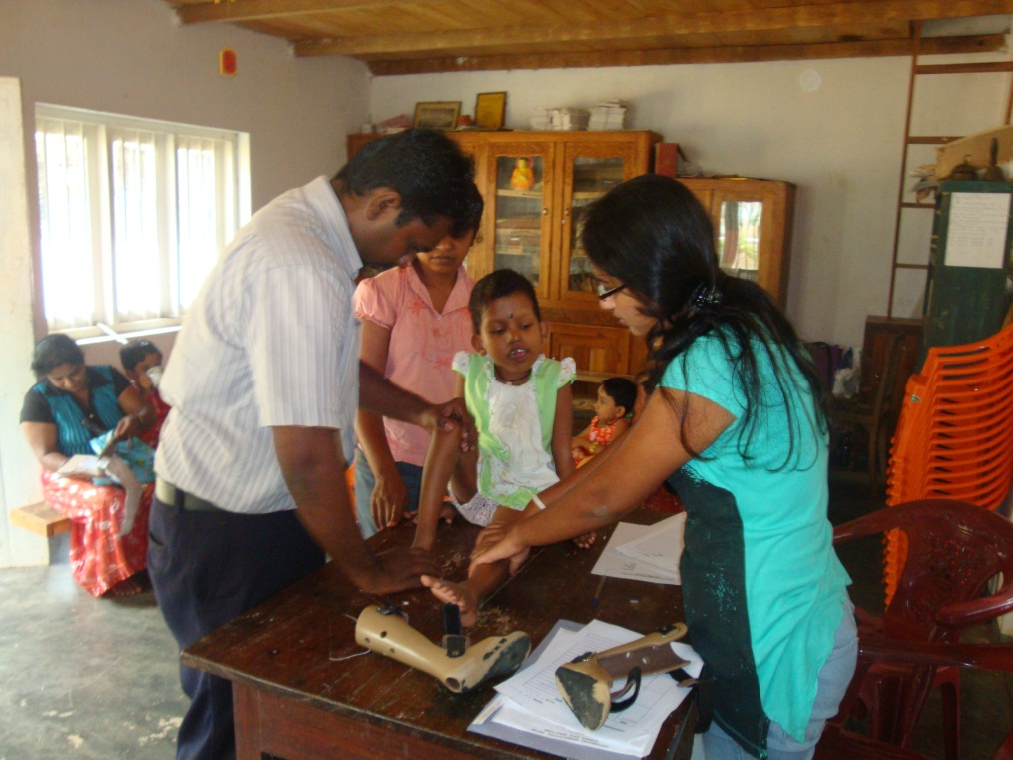
Some of my involvements in service provision for people with disabilities
Home visits in the field
Center-based community physiotherapy services

Slide 12
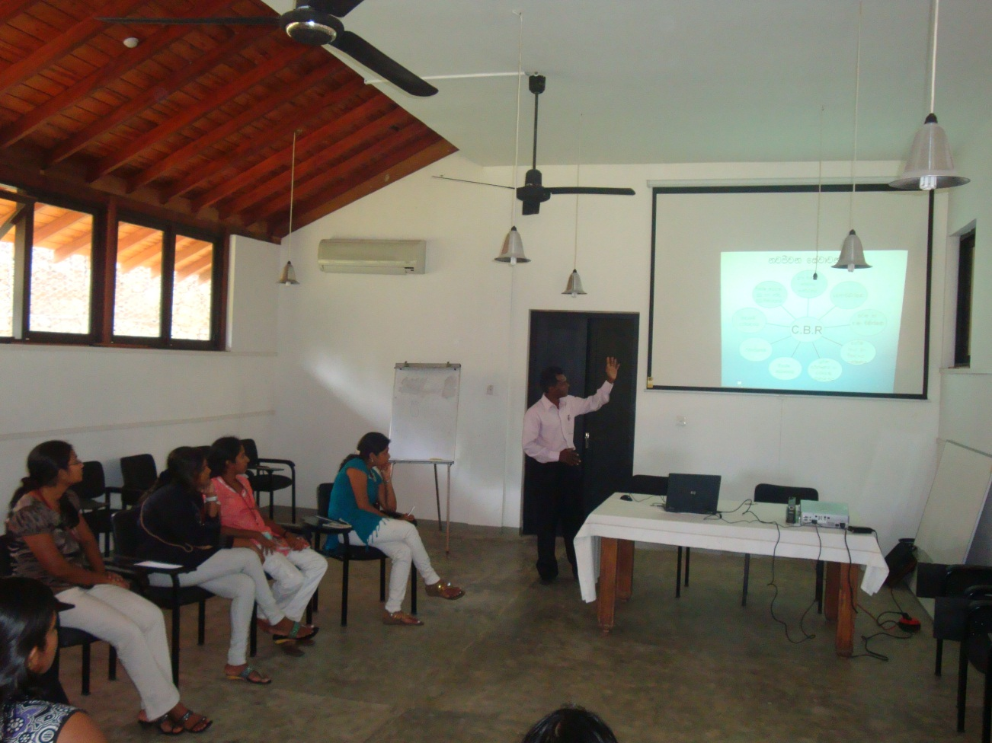
Participate in information sessions

Slide 13
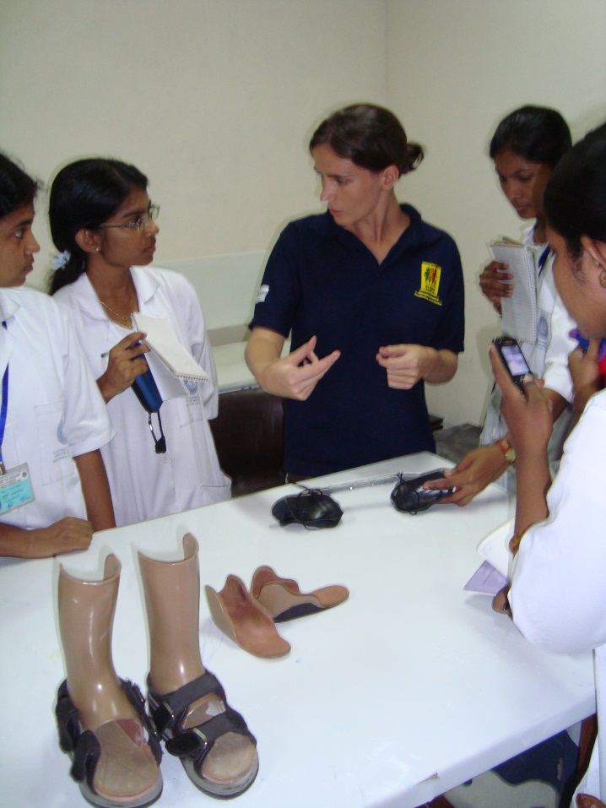
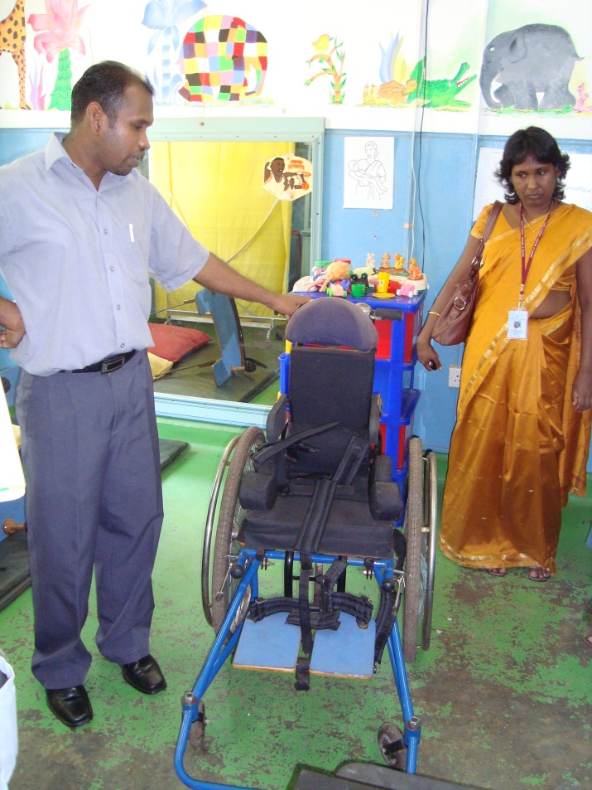
Participation in service delivery workshops

Slide 14
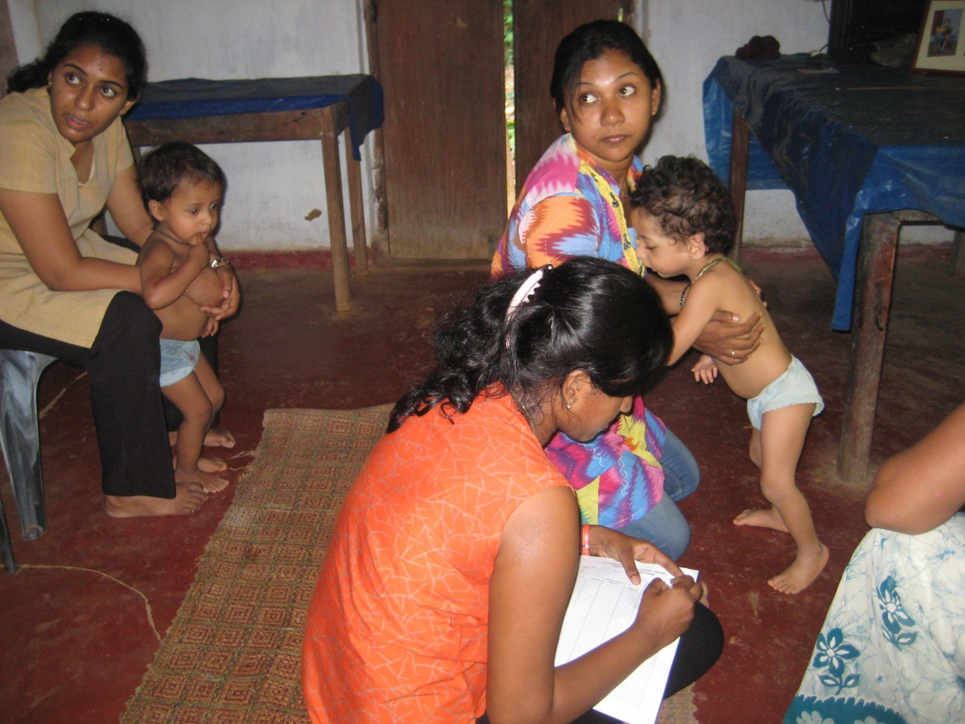
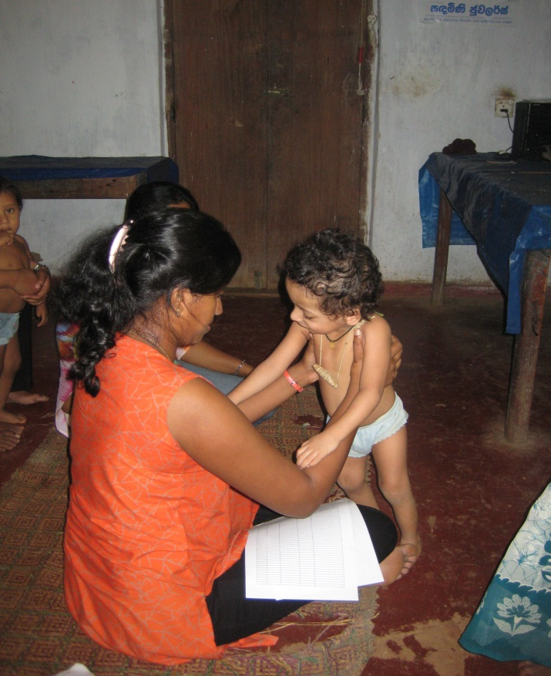
Home-based assessments & therapy sessions
Cerebral Palsy

Slide 15
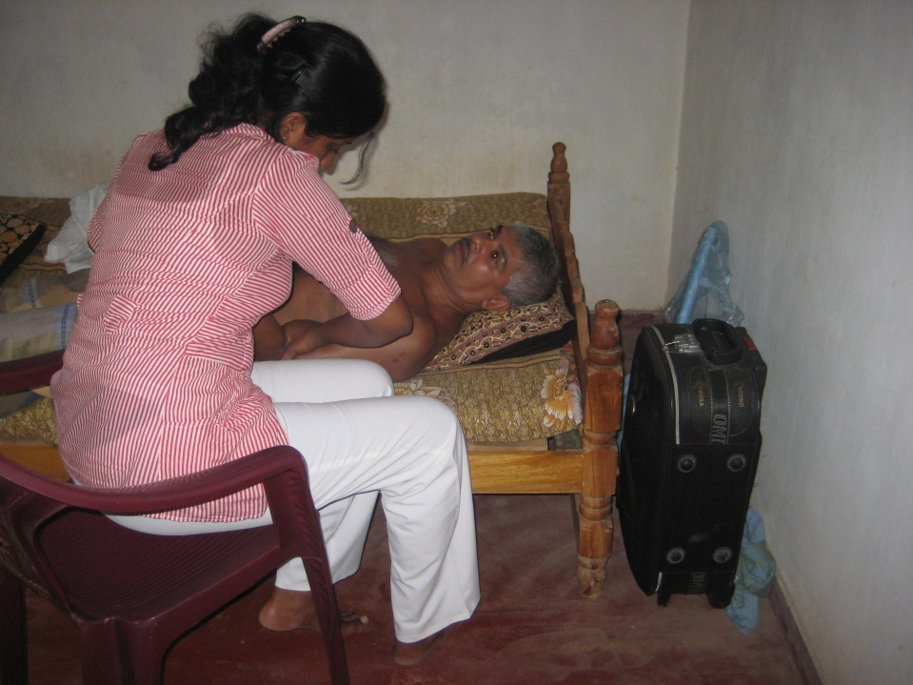
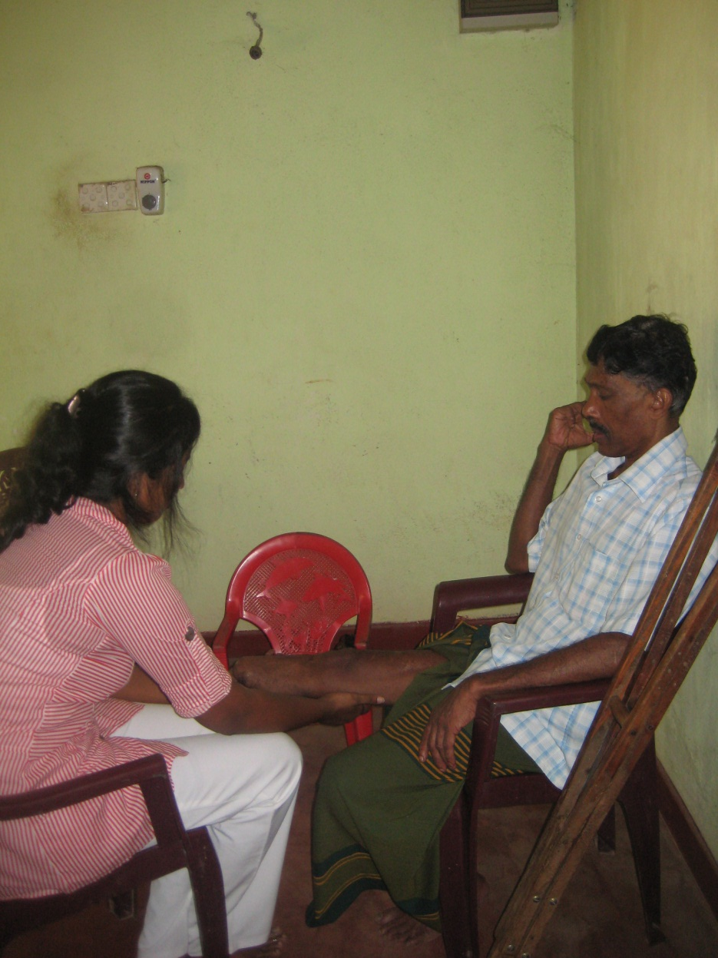
Amputee Rehabilitation
Stroke Rehabilitation

Slide 16
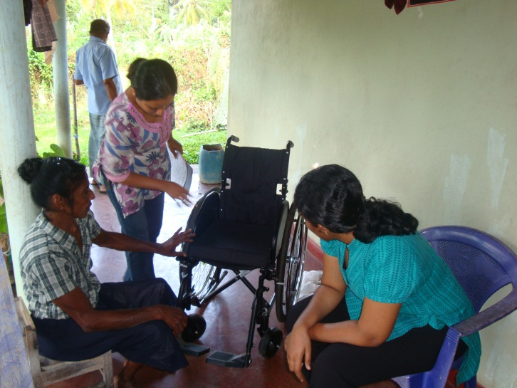
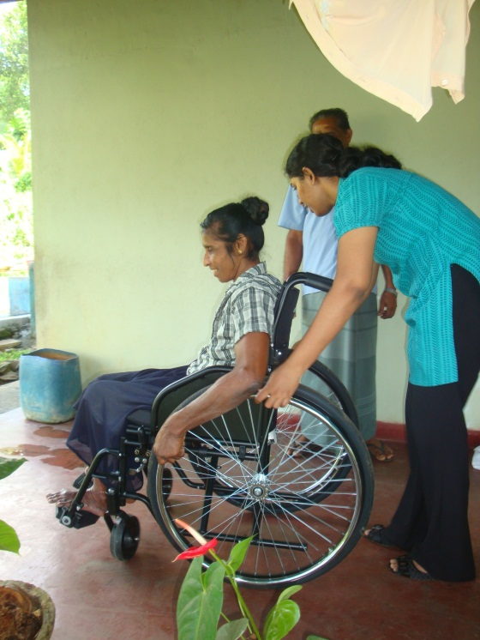
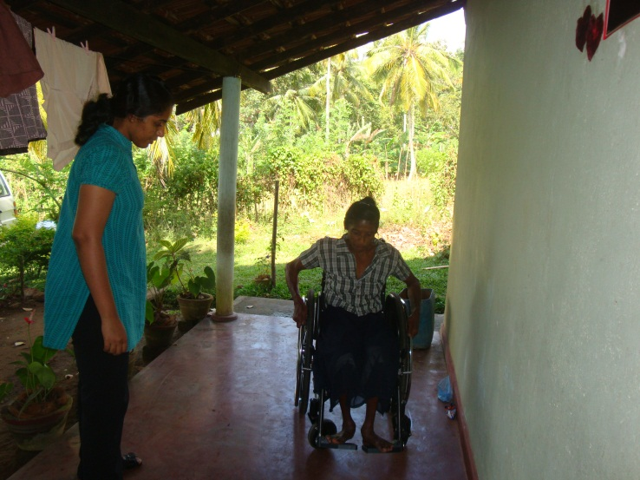
Wheel Chair Mobility Training

Slide 17
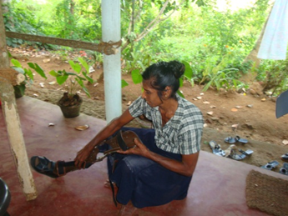
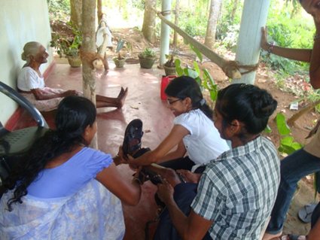
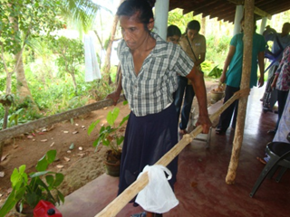
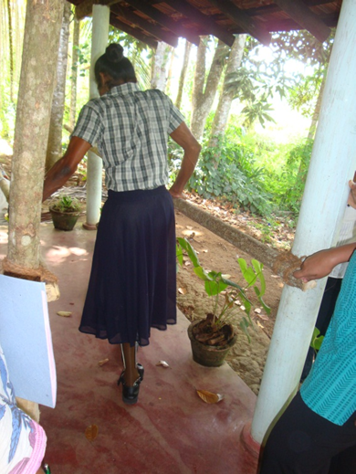
Prosthetic Application and Gait Training

Slide 18
My aim is to…..
To inclusion of “person first language” to address people with disability
Raising awareness to address hidden mental health issues of people with disabilities
Minimize physical as well as “attitudinal” barriers for people with disabilities to merge with the mainstream
People with disabilities people with different abilities
Develop effective collaborations of stakeholders who involve in service provision for people with disabilities
Within Sri Lanka…

Slide 19
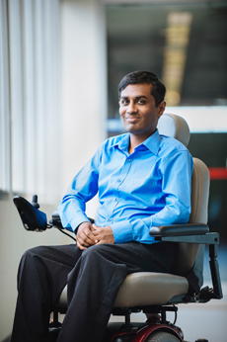
Special Remembering………
Sampath Dhanapala
Former university lecturer in Sri Lanka
Master’s student at Flinders University
Physically impaired due to Muscular Dystrophy
Had a great vision to become a disability advisor and serve the country with his knowledge and experience especially through disability advocacy and by establishing a center for helping with necessary knowledge and training to university leavers and young community with disabilities.
Passed away untimely in last December due to post-surgical complications.
But..
Flinders University- Disability & Community Inclusion Unit have expressed their interest to pursue Sampath’s vision by developing partnership with University of Peradeniya.

Slide 20
References
Department of Social Services, Sri Lanka. (2011). Overview.
Japan International Cooperation Agency Planning and Evaluation Department. (2002). Country Profile on Disability: Democratic Socialist
Republic of Sri Lanka. Retrieved from http://siteresources.worldbank.org/DISABILITY/Resources/Regions/South%20Asia/JICA_SriLanka.pdf
Protection of the Rights of Persons with Disabilities Act, No.28 of 1996

